Slide 1
Tree Limbing and Harvesting ROV
Team 15 Presenters:
Ryan Gaylord, Alex Glazer,
Nestor Riguad

Slide 2
Team Introductions
Nestor Rigaud
ME DESIGN
Christopher Ruiz
TEAM LEADER
Ryan Gaylord
LEAD
COMMUNICATIONS
Alex Glazer
ME PROGRAMMING
Donald Phillips
FINANCIAL ADVISOR

Slide 3
Recap
Project Scope
A ROV modeled after a Total Tree Harvester head
As the ROV climbs, it will de-limb the tree
Once at a certain height, the ROV will top the tree
As it’s descending, the ROV will section the tree
Alex Glazer

Slide 4
Target Catalog
Targets were assigned to each component of our functional decomposition and other factors
Secure to Tree
Climb the Tree
De-limb the Tree
Section the Tree
Other Targets
Alex Glazer

Slide 5
Targets
Secure to Tree | Maximum Opening Width | 25 in
 | Minimum Opening Width | 8 in
 | Maximum Clamping Pressure | 790 psi
 | Minimum Clamping Force to Climb Tree | 200 lbf
 | Minimum Clamping Force to Shear Limbs | 5,371 lbf
Climb the Tree | Rate of Climbing Tree | 30 ft/min
 | Maximum Tree Height | 60 ft.
Alex Glazer

Slide 6
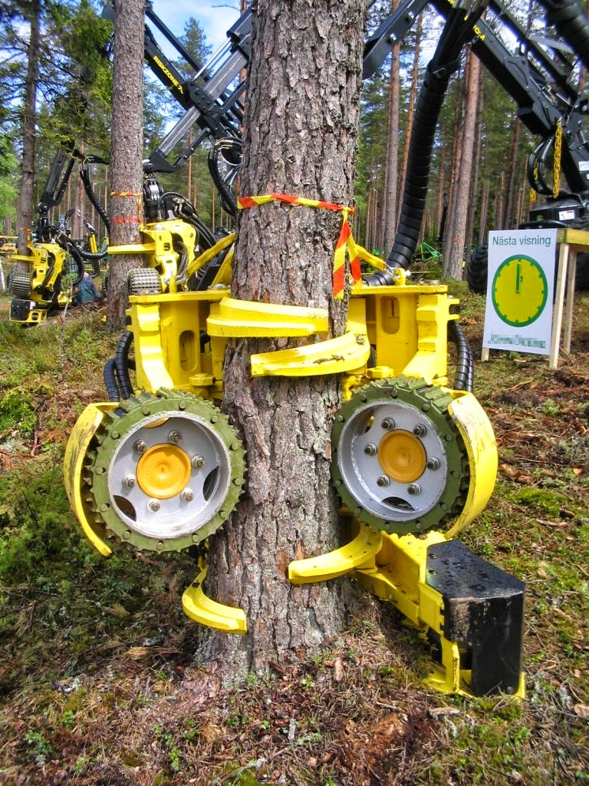
Targets: Securing to Tree
Opening width of ROV
Minimum = 8 in.
Maximum = 25 in
Alex Glazer

Slide 7
Targets: Securing to Tree
Maximum clamping pressure
790 psi
Minimum clamping force to climb tree
200 lbf
Minimum clamping force to shear limbs
5,371 lbf
Alex Glazer

Slide 8
Targets
Secure to Tree | Maximum Opening Width | 25 in
 | Minimum Opening Width | 8 in
 | Maximum Clamping Pressure | 790 Psi
 | Minimum Clamping Force to Climb Tree | 200 lbf
 | Minimum Clamping Force to Shear Limbs | 5,371 lbf
Climb the Tree | Rate of Climbing Tree | 30 ft/min
 | Maximum Tree Height | 60 ft.
Alex Glazer

Slide 9
Targets: Climb the Tree
Max height of tree = 60 ft.
Climbing rate = 30 ft/min
Alex Glazer

Slide 10
Targets
De-limb the Tree | Precision of Limb Shearing | 0.5 in. from tree
 | Force to Shear Limbs | 5171 lbf
 | De-limbing Rate | 10 seconds/limb
 | Maximum Limb Diameter | 5 in.
 | Minimum Limb Diameter | 1 in.
Section the Tree | Rate of Sectioning Tree | 30 seconds
Alex Glazer

Slide 11
Targets: De-limb the Tree
Maximum Limb Diameter
5 in.
Minimum Limb Diameter
1 in.
Force to shear limbs = 5171 lbf
De-limbing rate =
10 sec/limb
Precision = 0.5 in.
Alex Glazer

Slide 12
Targets
Section the Tree | Rate of Sectioning the Tree | 30 seconds/cut
Other | Max Weight | 200 lbs
 | Max Number of Controls | 10
 | Maximum Development Cost | $5,000
 | Operation Time per Tree | 1.5 Hours
 | Power Consumption | 130 kW
 | Range of Controller | 150 ft.
Alex Glazer

Slide 13
Targets
Section the Tree | Rate of Sectioning the Tree | 30 seconds/cut
Other | Max Weight | 200 lbs
 | Max Number of Controls | 10
 | Maximum Development Cost | $5,000
 | Operation Time per Tree | 1.5 Hours
 | Power Consumption | 130 kW
 | Range of Controller | 150 ft.
Alex Glazer

Slide 14
Concept Generation
Ryan Gaylord

Slide 15
Concept Generation
A morphological chart uses the functional parameters to explore various solutions for the customer requirements.
Climb
Securing
Movement Type
Limbing
Type
Guide
Electrical
Controller
Sectioning
Direct
Type
Cutting Approach
Ryan Gaylord

Slide 16
Climb
Securing
Ryan Gaylord

Slide 17
Climb: Securing
Hydraulics
Large force to weight ratio but can be complicated
Pneumatics
Simple, precise, and light but low force to weight ratio
Motor
No leaks and precise, but weak and risk overheating
Ryan Gaylord

Slide 18
Climb
Movement Type
Ryan Gaylord

Slide 19
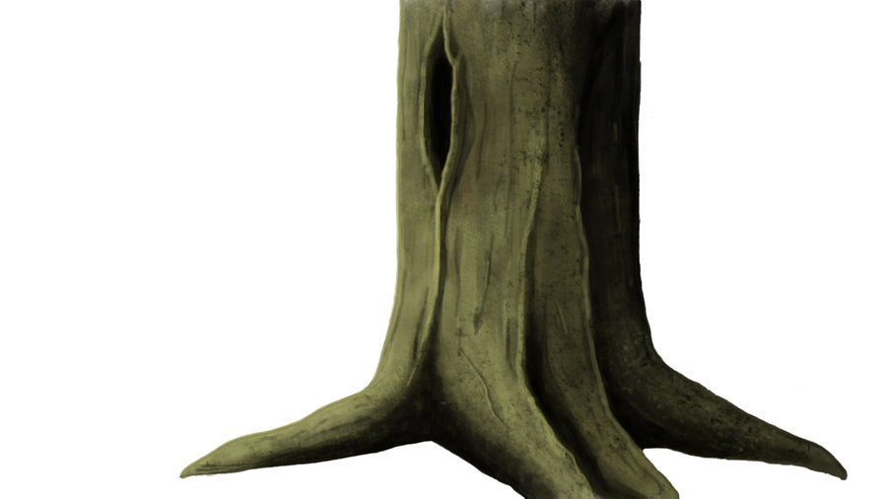
Climb: Movement Type
Wheels
Lower cost and simpler design, but low surface contact and difficulty over obstacles
Ryan Gaylord

Slide 20
Climb: Movement Type
Track
High surface contact and easily overcomes obstacles, but has many moving parts, adding weight
Ryan Gaylord

Slide 21
Climbs: Movement Type
Bear Hug Clamp
Ryan Gaylord

Slide 22
Limbing
Type
Ryan Gaylord

Slide 23
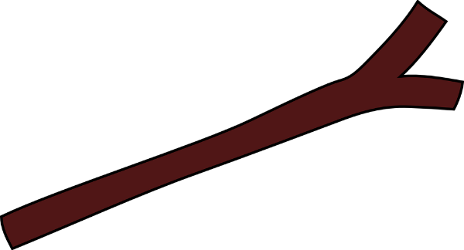
Limbing: Type
Shear
Simple design with few moving parts, but would require a greater force
Ryan Gaylord

Slide 24
Limbing: Type
Chainsaw/Circular Saw
Requires less force and has many moving parts. Involves a guide
Ryan Gaylord

Slide 25
Limbing
Guide
Ryan Gaylord

Slide 26
Limbing: Guide
Tracks
Allows cutting tool to revolve around the ROV
Stationary
Cutting tool attached rigidly to the ROV
Prismatic
Cutting tool attached by a prismatic joint
Ryan Gaylord

Slide 27
Sectioning
Type
Ryan Gaylord

Slide 28
Sectioning: Type
Shear
Uses a wedge at high force
Chainsaw
Greater cutting length and requires low force
Circular Saw
Requires low force but a smaller cutting length
Ryan Gaylord

Slide 29
Sectioning
Cutting Approach
Ryan Gaylord

Slide 30
Sectioning: Cutting Approach
Horizontal
Simplest method but little control of where the tree section falls
Ryan Gaylord

Slide 31
Sectioning: Cutting Approach
45 degree angle
More complicated than a horizontal cut but more control of the tree fall
Θ=45˚
Ryan Gaylord

Slide 32
Sectioning: Cutting Approach
V-cut
Most complicated design but also has the highest precision of tree fall
Ryan Gaylord

Slide 33
Designs
Nestor Rigaud

Slide 34
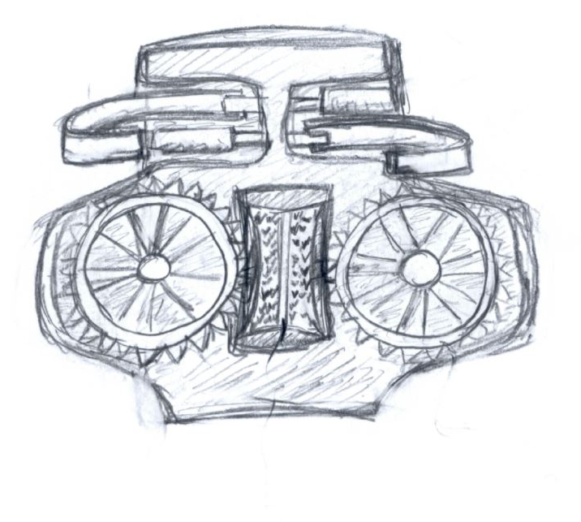
Design 1 (Datum)
Uses spiked wheels for movement type
Uses motors to climb up tree
Pneumatic clamping system
Nestor Rigaud

Slide 35
Design 1 cont.
A rigid shearing cutting tool
A chainsaw for sectioning the tree
Nestor Rigaud

Slide 36
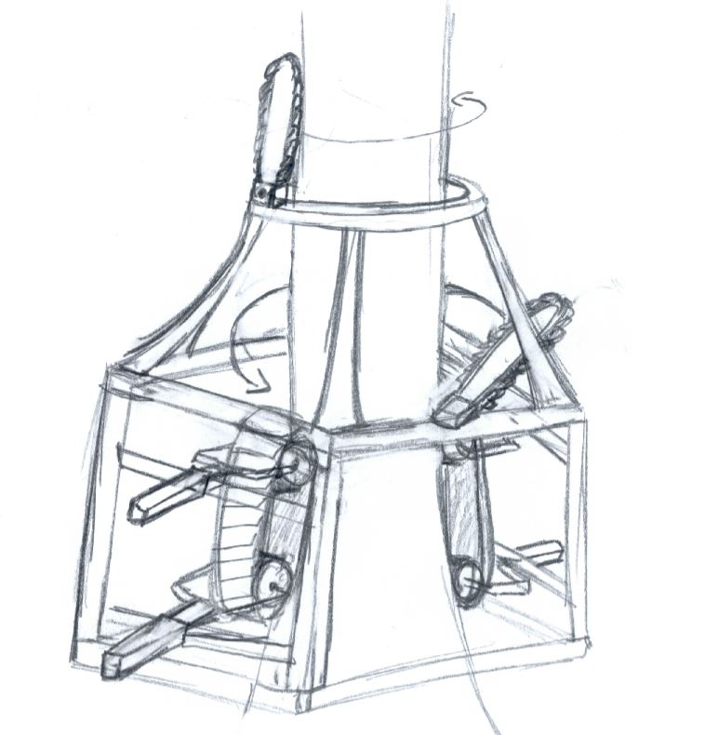
Design 2
Uses tread for movement type
Uses motors to clamp and drive the ROV up and down the tree
Chainsaws will de-limb and section the tree
Nestor Rigaud

Slide 37
Design 2 cont.
Rotating track will guide chainsaw around the tree for de-limbing
Second chainsaw will attached by revolute joint to section the tree.
Nestor Rigaud

Slide 38
Design 3
Uses bear hug clamping method for movement type
A hydraulic clamping system
Two clamps are connected by a prismatic joint to climb the tree
A shearing blade de-limbs by the hydraulic prismatic joint
Chainsaw will be used to section the tree
https://www.youtube.com/watch?v=Cr_ha4JSCJg&t=48s
Nestor Rigaud

Slide 39
Tree Harvesting ROV
The Next Step?
Nestor Rigaud

Slide 40
The Next Step
Concept Selection
Pugh Matrix
HOQ
Pre-Prototyping
Cardboard
CAD
Prototyping
CAD
Material Selection
Project Plan
Nestor Rigaud

Slide 41
References
[1] S. (n.d.). Naarva s23 Stroke Harvester. Retrieved November 08, 2017, from http://www.pentinpaja.fi/app/product/view/-/id/65/cat_id/10/set_language/en
[2] Loblolly Pine. (n.d.). Retrieved November 07, 2017, from http://www.wood-database.com/loblolly-pine/
[3] Pinus taeda. (n.d.). Retrieved November 07, 2017, from http://www.conifers.org/pi/Pinus_taeda.php

Slide 42
Tree Harvesting ROV
QUESTIONS?

Slide 43
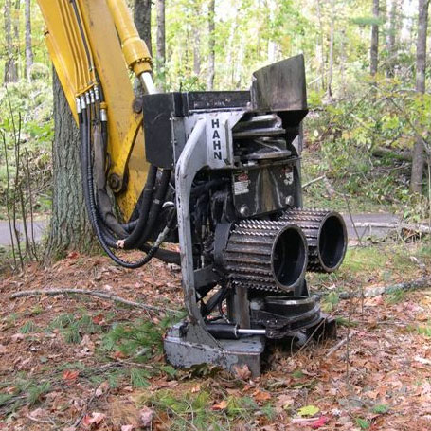
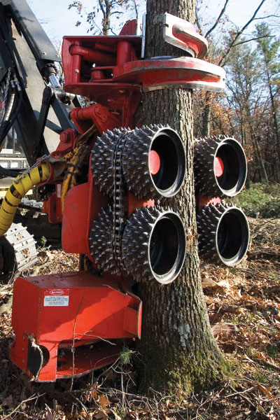
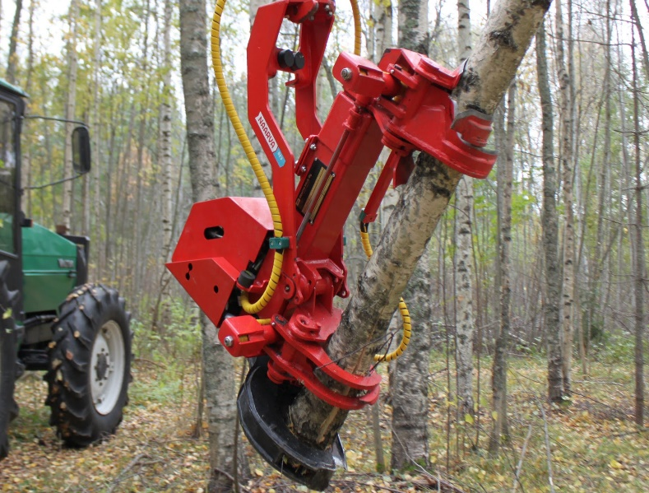
Back-Up Slides
Question 1
What are your designs based on?
[1]

Slide 44
Back-Up Slides
Question 2
How did you find the force to shear the limbs?
A book was found called “Tree Harvesting Techniques” that displayed an equation on how much force would be needed to shear a limb off a pine tree. We also benchmarked a tree harvester head using the specs on how much shearing force they put out when de-limbing.

Slide 45
Back-Up Slides
Question 3
What kind of trees will the ROV be used on?
Un-deformed straight trees up to 60 ft.
Mostly pine trees, specifically loblolly since these are the most abundant type of pine tree in the southeast [2] [3]

